Slide 1
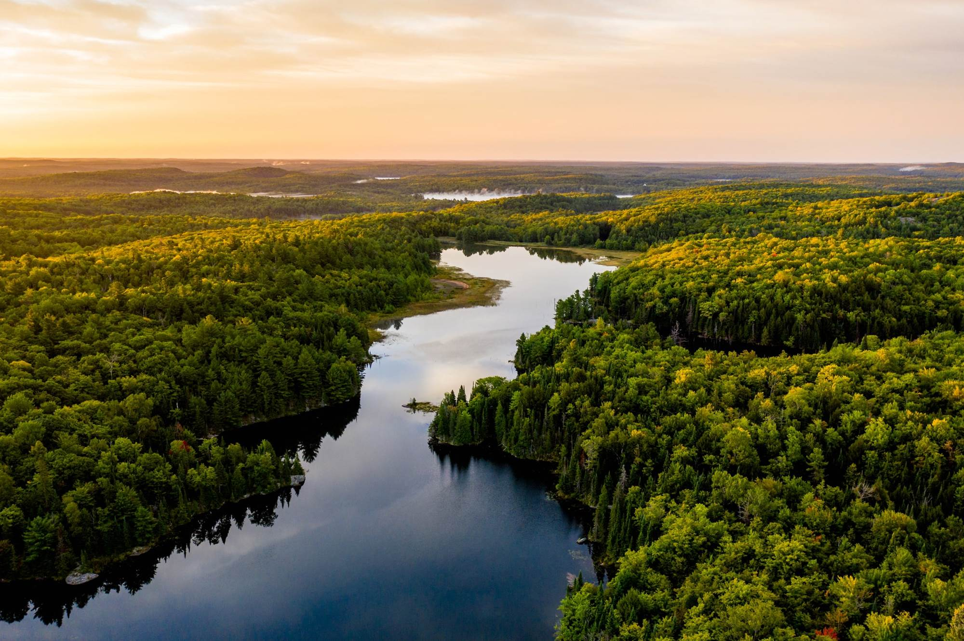
Radar Saas GreenTech
Study overview

Slide 2


Radar 2023
Saas GreenTech
Overview of digital ecological transition solutions for professionals

Slide 3


































































Radar presentation
The 2023 French
Carbon measurement
SaaS GreenTech radar
By
Committed HR policy
Mobility
Plan
Furniture
Sustainable premises
Pilotage RSE
Real estate
Impact of digital
technology
Green IT
Waste
Radar SaaS GreenTech | 2023
Impact of
Terminals
Resources optimisation
Energy efficiency
Green
communication
Wavestone © 2023

Slide 4

Background
and Purpose
Radar SaaS GreenTech | 2023

Slide 5



More and more of our clients from the banking sector are looking to partner with SaaS GreenTech in order to offer their services to their professional customer
Background and purpose
1
2
Professional bank customers have a strong need for support in their transition
GreenTech SaaS solutions represent an opportunity for banks to expand their range of green offerings
49M€
Financing for the environmental transition
At 31 December 2022
20 000
Companies transitioning to ecological sustainability by 2025
3
4
Banking institutions are increasingly involved in the fight against climate change
The SaaS GreenTechs market is attracting strong interest from investors
455 M€
Subscribed to energy and ecological transition funds
At 31 December 2022
Injected in favour of the ecological transition
Over the period 2022-2025
26,4Md€

Slide 6


The SaaS GreenTech market is rising, in a context where the global tech market is declining, with less and less money invested
Background and purpose
An explosion in GreenTech SaaS start-ups since 2020
The overwhelming majority of start-ups have fewer than 50 employees
Fundraising on the market varies widely
60%
of the 56 GreenTechs studied were created in the last 5 years
68%
of the 56 GreenTechs surveyed have between 11 and 50 employees
400 M€
raised by SaaS Greentech on the radar
63%
30%
of the 56 GreenTechs studied were created in 2020
4%
+100
Radar SaaS GreenTech | 2023
5%
51 à 100
23%
1 à 10
68%
11 à 50
Breakdown of 56 GreenTech SaaSs analysed by creation date
Distribution of the 56 analysed GreenTech SaaS solutions by workforce
Breakdown of funds raised by GreenTech SaaS solutions within the analysed scope, by series type
Notes:
Un nouveau record de créations d’entreprises en 2020 malgré la crise sanitaire - Insee Première – 1837 « Un nouveau record de créations d’entreprises en 2020 malgré la crise sanitaire”

Slide 7

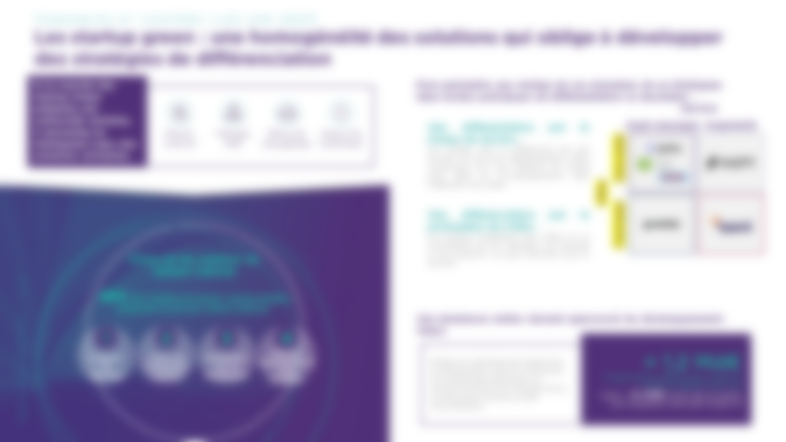




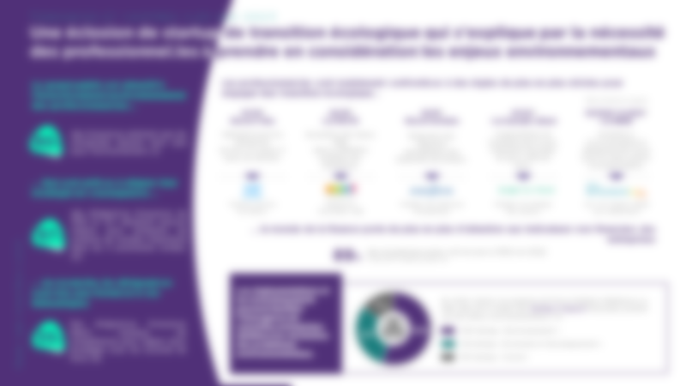

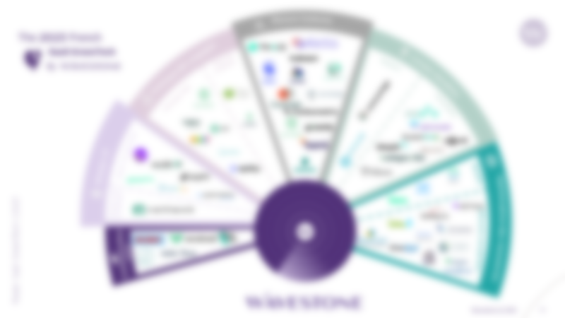

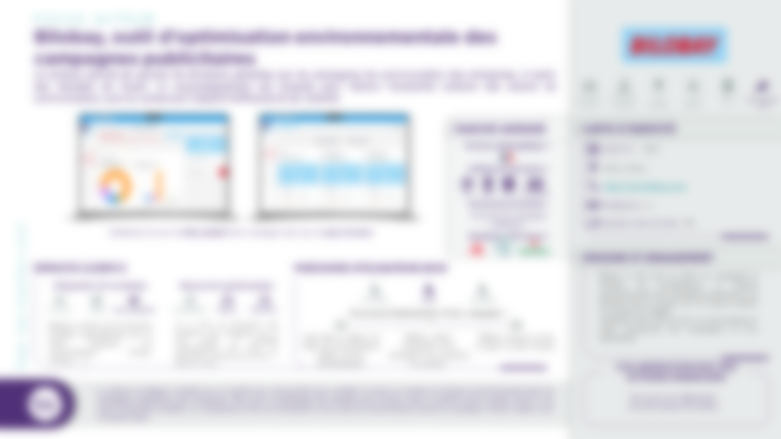



An in-depth study targeting the financial sector, aiming to assist its professional clients in their transition process
Background and purpose
Our approach…
… Will allow you to :
1
Identify current and future major market trends.
UNDERSTAND
The needs of professionals in terms of ecological transition and the key levers of action to support them.
2
Radar SaaS GreenTech | 2023
Analyse market players based on the major axes of business transformation.
ANALYSE
Market trends and their influence on your partnership approach to the ecological transition of your professional customers.
3
Qualify in depth the value proposition of 16 key market players.
CHOOSE
The partners best suited to your needs and those of your customers to highlight in your marketplace for professionals.

Slide 8
Our main
learnings
Radar SaaS GreenTech | 2023

Slide 9








A blossoming of ecological transition start-ups, driven by the necessity for professionals to consider environmental challenges.
Our main learnings
The general public is attentive to the environmental investment of professionals…
Professionals are now faced with increasingly stringent rules to help them make the ecological transition...
* Effective date
07/16*
Décret 5 flux
05/19*
Loi PACTE
10/19*
Décret tertiaire
07/22*
Loi énergie-climat
01/2022* & 2024*
Loi REEN
80%
of French people think that companies should do more for the environment. (1)
Obligation for companies to sort 5 types of waste at source.
Incorporating CSR issues into the legal definition of companies.
Reducing energy costs in commercial buildings.
Increase in the fine for failing to carry out a greenhouse gas assessment.
Incentives for eco-design and tax relief for eco-responsible data centres.
… Who are prepared to align their strategy accordingly …
Radar SaaS GreenTech | 2023
Tracking des flux de matière
CSR leadership platform
Managing energy expenditure
Steering low-carbon strategy
Tracking digital impact per employee
of French SME and ISE managers say they can significantly reduce their carbon emissions over the next 5 years. (2)
87%
… the world of finance is paying increasing attention to companies' non-financial indicators
89%
of investors will use CSR in 2022.
Compared to 84% the year before (4).
… on the other hand, managers receive very little training on these issues
Regulations and investment can facilitate the emergence of new companies dedicated to solving environmental problems.
In 2022, according to a mapping by France Digitale & Bpifrance Le Hub, more than half of French impact start-ups will be working on environmental issues. (5)
163
35%
French managers say they lack the skills to align their strategies with the Paris agreements (3)
321
590
590 start-ups « Environment »
321 start-ups « Economy and development »
163 start-ups « Social »

Slide 10












Green start-ups: homogenous solutions forcing SaaS GreenTech to develop differentiation strategies
Our main learnings
There are two main ways in which start-ups in these fields can differentiate themselves:
Of the 6 areas we have identified in the GreenTech SaaS market, 4 stand out and account for more than 60% of the start-ups studied
Service
Differentiation through service levels:
Start-ups will differentiate themselves by offering additional levels of service. They partner with consultancies to offer support in using the tools.
Classic SaaS
Augmented
Carbone
Measurement
CSR
Management
Energy efficiency
Green
IT
Niche
Differentiation by the type of market addressed:
Start-ups can position their offerings by focusing on specific markets, such as transport or digital.
Addressed market
Global
Radar SaaS GreenTech | 2023
Focus on carbon measurement solutions
95% of the carbon measurement solutions studied offer a similar customer journey:
Clear trends point to future developments
1
2
3
4
Data
collection
Carbon
footprint calculation
Restitution
on a
Dashboard
Recommenda-tions and action plan
+ 1,2 bn€
Investment in green start-ups in 2022 in France compared with 2021. (6)*
Compared to -$25bn invested in European tech start-ups between 2021 and 2022. (7)
Despite an overall slowdown in investment in digital technology companies, GreenTechs are doing well and attracting more and more investors.
Notes:
*Climate Tech Report 2022 - Tech Nation
**https://urldefense.com/v3/__https://netzeroinsights.com/wp-content/uploads/2022/10/Net-Zero-Insights-State-of-Climate-Tech-Q3-2022-.pdf__;!!NEMsmePo_HYI!ejywGTCBN1W1tfxSS3xY7f-tHL-sK6HrOFWaJI71P__5bjgD2A-9si8LBihHATAG22KJSbgekrE3wS5PCHP6FUUSQKw$
***https://www.bpifrance.fr/nos-actualites/les-greentech-francaises-ont-affiche-un-chiffre-daffaires-de-plus-de-3-milliards-deuros-en-2021
****Air et fumé – Décarbonisation – Eau-Sols-éco circulaire-Biodiversité-Accompagnement à la transition numérique et durable

Slide 11
Radar
Presentation
Radar SaaS GreenTech | 2023

Slide 12
Radar presentation
The 2023 French
Carbon measurement
SaaS GreenTech radar
By
Committed HR policy
Mobility
Plan
Furniture
Sustainable premises
Pilotage RSE
Real estate
Impact of digital
technology
Green IT
Waste
Radar SaaS GreenTech | 2023
Impact of
Terminals
Resources optimisation
Energy efficiency
Green
communication
Wavestone © 2023

Slide 13





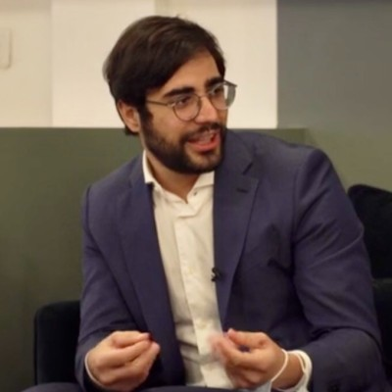
Authors
Contributors
Haithem ALOUI
Consultant Financial Services
haithem.aloui@wavestone.com
Tony BEYNETTE, Marianne DEHAY ARMESSEM, Amina KHEMAKHEM, Brice LEURQUIN, Eloise KONECNY VELLER, Laurie MASSELOT, Marie THIBOUVILLE
Omar AOUAD-SAOUD
Senior Consultant Financial Services
omar.aouad-saoud@wavestone.com
Zoé DUARTE
Consultant Financial Services
zoe.duarte@wavestone.com
Radar SaaS GreenTech | 2023
Acknowledgements
We would like to express our sincere gratitude to all those who contributed to the creation of this overview of digital solutions for ecological transition for professionals. Your commitment, expertise, and enthusiasm have provided us with valuable insights into the positioning and sustainable practices implemented by industry players. Your contribution has been essential in creating a valuable tool for those who seek to take concrete action for a more sustainable future for their clients.
Irene ROVATTI
Analyst Financial Services
irene.rovatti@wavestone.com
Etienne SCOTTO D’APOLLONIA
Manager Financial Services
etienne.scotto-dapollonia@wavestone.com

Slide 14
Sources
Glossary
Rapport « indice de l’engagement sociétal », BrightHouse et BCG GAMMA, 2020
Les dirigeants de PME-ETI face à l’urgence climatique, Bpifrance Le Lab, 2020
Etude « EU Green Deal », PWC, 2022
CSR Global Study 2022, CapitalGroup, 2022
Mapping des startup à impact françaises, France Digitale & Bpifrance Le Hub, 2022
Climate Tech Report 2022 - Tech Nation
Etude Atomico
GreenTech: technology whose use aims to mitigate or reverse the effects of human activity on the environment.
Ecological transition: the ecological transition is a move towards a new economic and social model, a model of sustainable development that renews the way we consume, produce, work and live together to meet the major environmental challenges of climate change, scarcity of resources, accelerated loss of biodiversity and increasing environmental health risks.
Sustainability: the ability to meet the needs of the present without compromising the ability of future generations to meet their own needs.
Paris Agreement: international agreement signed in 2015 with the aim of combating climate change by limiting the rise in global temperature to less than 2 degrees Celsius above pre-industrial levels, and pursuing efforts to limit the rise to 1.5 degrees Celsius. The signatory countries have pledged to reduce their greenhouse gas emissions and to work together to achieve this goal.
Ecodesign: ecodesign, as defined by the REEN law, consists of integrating the environmental impact of products or services from the design stage, taking into account the entire life cycle of the product, and seeking to minimise this impact, in particular by encouraging the use of renewable raw materials and limiting waste production. The aim is to contribute to the transition towards a circular economy that is more respectful of the environment.
Impact start-up: start-up that aims to solve social or environmental problems while having a viable business model and seeking to grow rapidly.
Carbon footprint: assessment of greenhouse gas emissions linked to an activity or an organisation, making it possible to identify the main sources of emissions and propose actions to reduce them.
Carbon footprint - Scope 1: concerns direct greenhouse gas emissions from sources owned or controlled by the organisation, such as emissions from the combustion of fuels in the organisation's facilities.
Carbon footprint - Scope 2: concerns indirect greenhouse gas emissions resulting from the production of electricity, heat or steam imported and consumed by the organisation.
Carbon footprint - Scope 3: concerns indirect greenhouse gas emissions resulting from the organisation's activities but generated by sources not owned or controlled by the organisation, such as emissions linked to the production of raw materials for the organisation's products, emissions linked to the transport of goods and services, and emissions linked to the use and end-of-life of the organisation's products.
Environmental labelling: environmental labelling consists of providing information on the environmental impact of a product or service, using indicators such as greenhouse gas emissions, water consumption, use of raw materials, etc. This information can be displayed on the product or service itself, or on its packaging, to help consumers make more sustainable decisions. This information can be displayed on the product or service itself, or on its packaging, to help consumers make more sustainable decisions. Environmental labelling can be voluntary or regulatory, depending on the country and sector of activity.
Green IT: the use of information and communication technologies (ICTs) to reduce their environmental impact, in particular by optimising energy consumption and electronic waste management.
SDGs: the Sustainable Development Goals are the 17 targets set by the UN in 2015 that member states want to achieve by 2030.
Radar SaaS GreenTech | 2023

Slide 15

Discover the complete study on the Wavestone’s blog :

